Slide 1
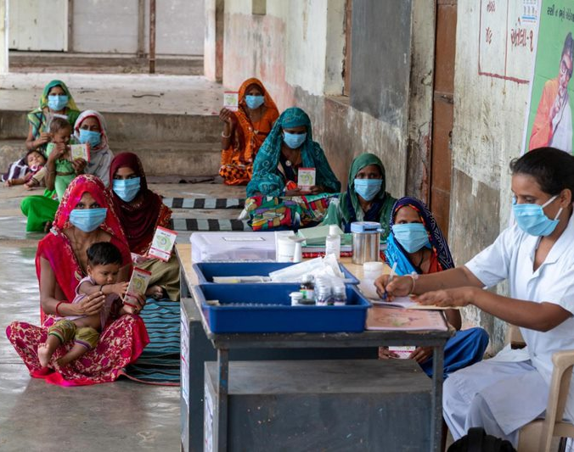
Health care app
By team TEAM

Slide 2
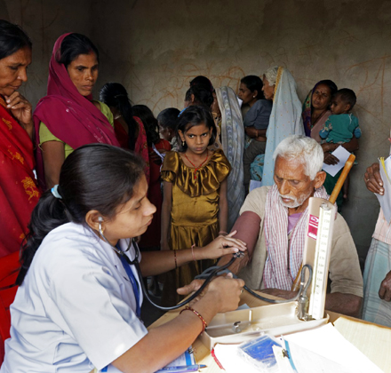
About us
We are the students of IIIT-H and want to contribute towards improvement in rural health care through mobile technologies and increasing their access to health care resources.

Slide 3
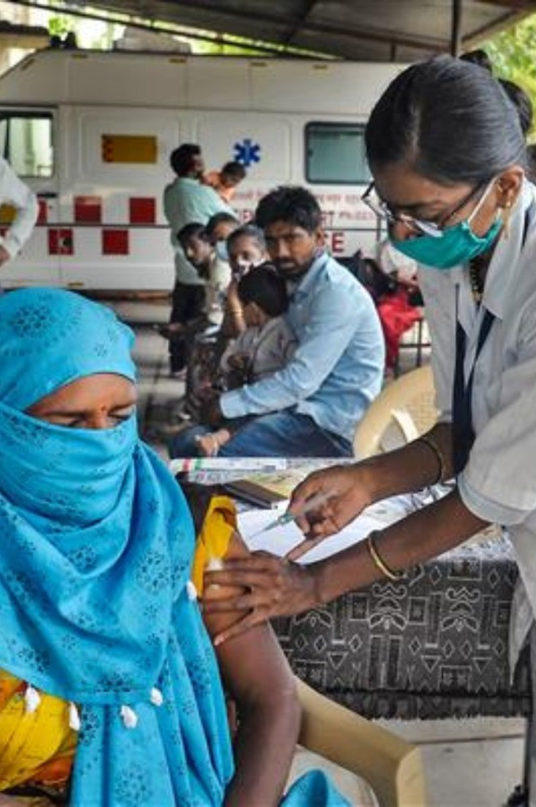
Problems
Rural India has 3.2 government hospital beds per 10,000 people and rural people can only afford government hospitals.
70 percent of India’s population live in rural areas and a significant percentage of that population lacks access to healthcare.
The doctor to patient ratio in rural area is 0.74 : 1000.
Almost 122 Indians per 100,000 die due to poor quality of care each year.
The main health care problem in rural areas is less access to health care and less awareness of health education.

Slide 4

Basis of Idea
StackOverflow
Stack overflow website -> contains already answered questions -> we therefore use the previous answers and take help from them…
Taken reference from Stack overflow website as the problem/ symptoms mentioned by the patient through voice/text we will search through the databased based on the tag. Further details in the upcoming slides.
Hence we similarly use this concept and record the pre-consultations and provide them to the patients.
Link - https://stackoverflow.com/

Slide 5

Basis of Idea
doubtnut
Audio/Video Solutions to the Problems. For example, The doubtnut App where as the students ask their questions and find solution videos related to it using tags recognition and transcript matching.
While in the app, as the dataset increases the medicine autosuggestion can be made possible based on the weights assigned by doctors in previous consultations.
So the patients can identify themselves with previous patients problem , example our app shows the match (i.e. 90% , 91 % match) using AI/ML based algorithms (applied on previous and present patient’s audio).
Link - https://www.doubtnut.com/

Slide 6
Solution
Our main motto is to increase the doctor to patient ratio and provide better health facilities and health-related awareness to the rural people.
For this we store the video and audio of doctor and patient consultation so that when a similar health issue is encountered in the future, we can simply provide that video and audio to the patient.
This allows us to reduce the physical involvement of the doctor and also time taken to address the issue.
We also assign nearby hospitals to the rural areas so that hospital to patient ratio can increase.
We provide multiple awareness videos for educating rural people about healthcare.
To cater all these needs we will make an app which would handle all these.

Slide 7
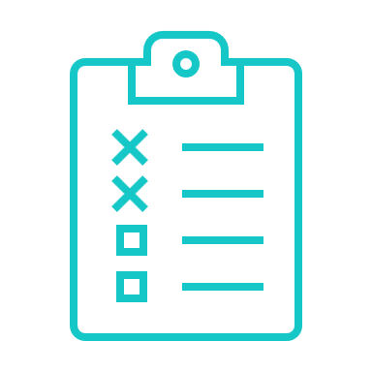
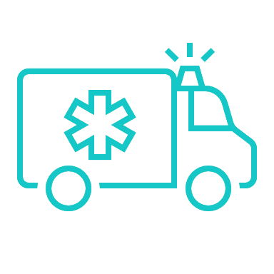



APP DESCRIPTION
Get consultation
Emergency
Situation
Reminders
Medicine store
Exercise record

Slide 8
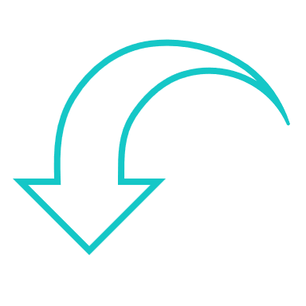
Get consultation
The patient should enter his/her symptoms here. He/She can enter in the form of text, audio,video,photo,etc.
From our recorded database we will search for the video which best matches to the entered symptoms and we will list down all such videos.
We will try to list videos with respect to his/her nearest location consulting, increasing the chances of videos in the patients native language so that he/she can understand the video properly.
If the patient is not satisfied with the video he/she can opt for online/offline consultation with the doctor.
In the online mode, we will provide a list of doctors according to type of disease. The patient can fix the appointment by choosing from the given list.
In the offline mode we provide list of appointments of the hospital with distance and rating of the hospital.

Slide 9
The medicine doses can be directly linked to the reminder section of the app as prescribed by the doctor in video but since the heavy medicines cannot be assigned to the patient if the match is not very close to 100% as they may lead to side-effects.
For this in our scheme, the doctors can level the medicines according to light and heavy/antibiotic,
So that the light medicines are assigned to the patient whose problem is like the video problem.
For heavy medicines he/she can visit the hospital. i.e. if he/she feels somewhat more ill in near days.

Slide 10
Emergency situation
For severe cases like pregnancy, cardiac arrest, shock , seizures our app provides a special service.
Here we notify the nearest hospital to send ambulance as soon as possible to the given address.
We also provide the patient with Pre-arrival instructions until the ambulance arrives

Slide 11
Reminders
Reminder consists of various things like
medicine reminder
appointment reminder
check-up reminder
exercise reminder
The reminder is set by the doctors. This helps the patient in taking medicines regularly and thus improving overall health of the patient.

Slide 12
Medicine Store
While prescribing the medicine, the doctor orders the medicine via the app to the patient.
The patient can track the status of his/her order and can also gets notified by a call when the order arrives.

Slide 13
Exercise record
The exercises recommended by the doctor will be fed by the doctor in app. The app will remind user of the activities and also keep record of the daily activities done by the patient.
Tracking of steps walked, calories burnt, etc.
We will add this type of technology in our app. Link - here
E.g. Tracking of heart rate. Link - here

Slide 14
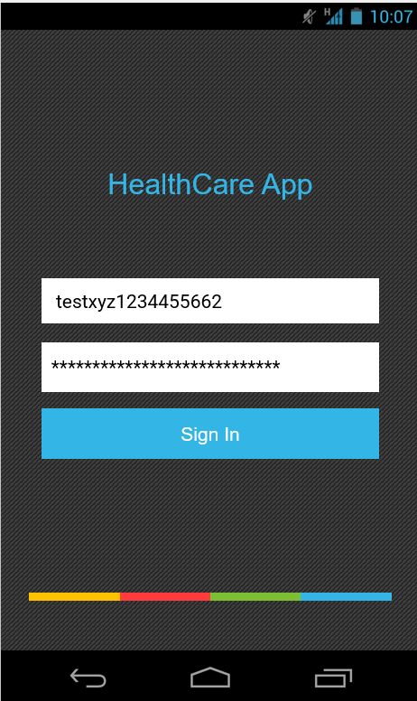
APP Prototype
The full app description and working is shown in another Power point presentation.

Slide 15
Meet the Team team
Chirag Jain
Rohan Kumar
Aman Raj
Manav Shah
Yash Kawade

Slide 16
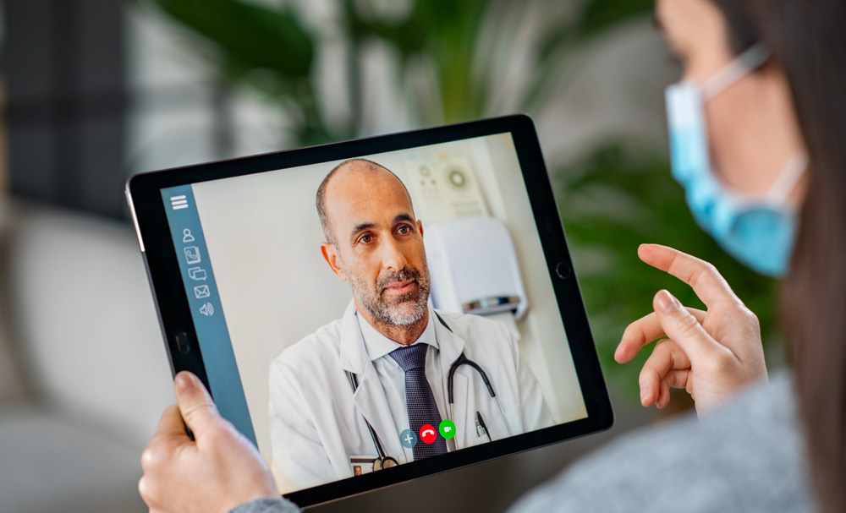
Thank you

